Slide 1
Optimizing IAB Therapy with Fiber-optics and High Efficacy Balloons
ML-0589-01 Rev A
MCV00039629 REVA

Slide 2
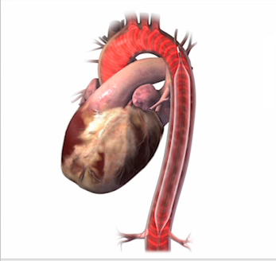
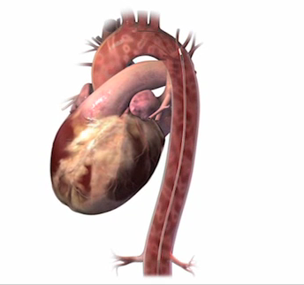
Physiologic Principles of IABP
The IAB inflates in diastole Augments diastolic pressure
Increases coronary perfusion and mean arterial pressure (MAP)
The IAB rapidly deflates prior to systole
Reduces end diastolic and systolic pressure
Decrease LV workload
Inflation: Increases diastolic aortic pressure and augments coronary blood flow
Deflation: Reduces aortic and left ventricular systolic pressure or afterload
Kapur et al. J Invasive Cardiol 2015;27(4):182-188
Notes:
Intra aortic balloon therapy has been used for over 50 years to assist in stabilizing hemodynamically compromised patients. By a simple process of inflating and deflating a balloon in the aorta. The inflation of the balloon during diastole the diastolic pressure is increased augmenting the coronary blood flow. Just prior to systole the IAB deflates reducing the diastolic and systolic pressure reducing the afterload which results in a reduction of workload of the heart.

Slide 3
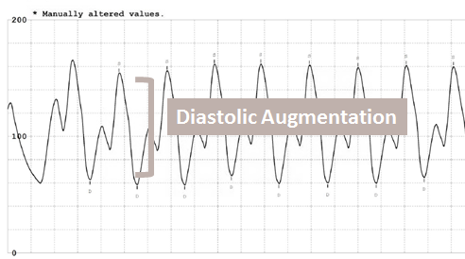
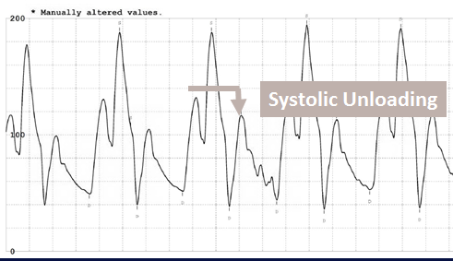
Benefits of IAB Therapy
IABP 1:1
IABP 1:2
↑ Coronary Perfusion Pressure
↑ Coronary Blood Flow
↑ Myocardial Oxygen Supply
↓ LV Wall Tension/Afterload
↓ LVEDP
↑ Cardiac Output
↓ Myocardial Oxygen Demand
Diastolic Augmentation
Difference between non-augmented and augmented diastolic pressure
Systolic Unloading
Difference between unassisted systole and assisted systole pressure
Parissis et al. Journal of Cardiothoracic Surgery (2016) 11:122
Notes:
When the balloon inflates during diastole, it causes a rise in the diastolic pressure called diastolic augmentation. This provides for improved coronary perfusion pressure, coronary blood flow and myocardial oxygen supply. When the balloon deflates it creates a decrease in the afterload making it easier for the heart to eject. This results in a lower systolic pressure called systolic unloading. The lower afterload decreases the left ventricular wall tension, decreases the end diastolic pressure in the left ventricle, increase the cardiac output and decreases the myocardial oxygen demand. In very simple terms, it increases supple and decreases demand.

Slide 4
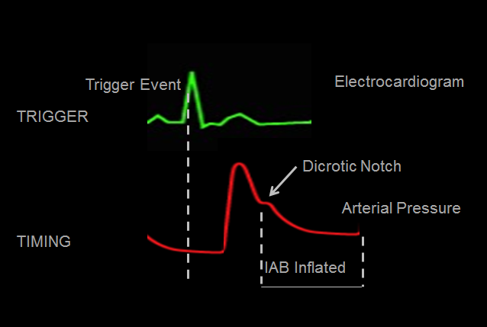
Timing and Trigger
The IABP is synchronized with the cardiac cycle
Timing- where the IAB is set to inflate and deflate using the arterial waveform
Trigger- event that signifies the beginning of a cardiac cycle
Parissis et al. Journal of Cardiothoracic Surgery (2016) 11:122
Notes:
In order to synchronize the inflation and deflation with the cardiac output, the IABP requires a trigger and appropriate timing. Timing is when the balloon is set to inflate and deflate. The trigger is the event that signifies the beginning of the cardiac cycle. If a beat comes in early, the trigger event will cause the balloon to deflate on the trigger signal, for example, the R wave of the ECG. Trigger is a safety net.

Slide 5
Timing is Everything
The hemodynamic effects of the IABP have the most benefit when the balloon is deflated simultaneously with the start of contraction, whereas inflation before onset of diastole unconditionally interferes with ejection
Accurate timing is critical.
Yarhman G et al. Perfusion 18(2) 97-102 September 2012
Notes:
If the timing is not set correctly then the support capabilities of the pump are lessened. Accurate timing is critical!

Slide 6
Conventional fluid filled arterial line

Slide 7
Importance of Quality Arterial Pressure Monitoring
IABP algorithms evaluate several key landmarks on the arterial pressure waveform to establish timing
Dicrotic notch signifies closure of the aortic valve and is a critical landmark used for inflation timing
Deflation is set prior to the opening of the aortic valve as signified by the upstroke of systole
Aortic valve opens
Yarhman G et al. Perfusion 18(2) 97-102 September 2012
Notes:
The arterial line is used to identify the key landmarks necessary for accurate timing. The dicrotic notch is the landmark used for inflation. Typically the ECG is used as the trigger but when it is not available the arterial line can also be used to identify the beginning of the next cardiac cycle. ECG Trigger is not always possible during IABP therapy, thus quality of arterial pressure waveform is a crucial necessity.

Slide 8
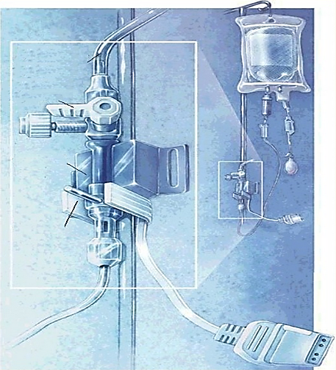
Conventional Fluid Filled Arterial Line
Traditional IAB catheters transmit a pressure signal through the fluid-filled inner lumen to an external pressure transducer, then to the pump via a pressure transducer cable
The technology has many challenges to maintaining accuracy
Low-compliance pressure tubing
Three-way stopcock
Transducer
Fast-flush device
Yarhman G et al. Perfusion 18(2) 97-102 September 2012
Notes:
Traditional IAB catheters use a standard arterial signal that goes through a fluid-filled arterial tubing to a transducer then to the monitor via a cable. There are many challenges in maintaining the accuracy of fluid-filled arterial line.

Slide 9
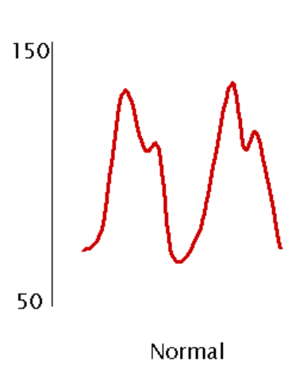
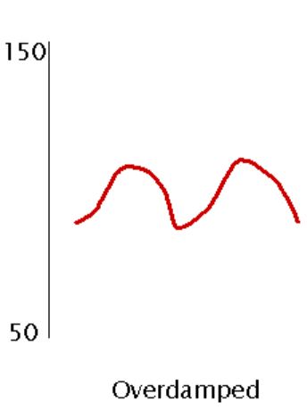
Conventional Fluid Filled Arterial Line Errors
Overdamping
Overdamping decreases the frequency response too much, underestimating the systolic BP and overestimating the diastolic BP creating a flattened waveform that does not reflect the patient's pressures¹
Can mimic hypotension leading to inappropriate or unnecessary treatment¹
Common causes²
Blood clots
Air bubbles in the tubing
Kinked line
Soft or non-compliant arterial tubing
https://acphospitalist.org/archives/2009/11/tech.htm
https://aneskey.com/avoid-errors-in-invasive-blood-pressure-measurement/
1.
Notes:
Overdamping decreases the signal frequency going to the monitor. It can cause the systolic blood pressure to read too low and the diastolic pressure to read too high. This flattened waveform does not accurately reflect the patient’s true blood pressure and can mimic hypotension. This can lead to inappropriate and unnecessary treatment. Common causes are blood clots in the line, air bubbles in the tubing, kinks in the line or compliant or soft arterial tubing.

Slide 10
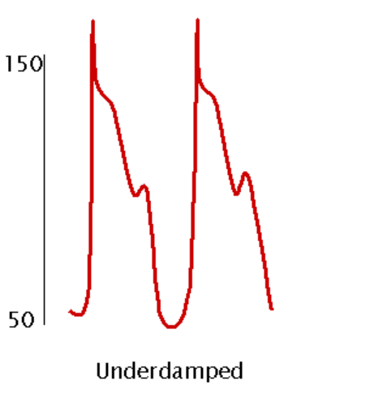
Conventional Fluid Filled Arterial Line Errors
Underdamping
Underdamping overestimates the systolic BP and underestimates the diastolic BP. May cause the appearance of additional, small pressure waves on the tracing (artifact).
Can lead to incorrect assumptions of hypertension and physiologically inappropriate treatment.
Common causes
Long connecting lines
Small diameter tubing
Catheter is too large for the vessel
Slow degradation in signal requiring flushing
https://aneskey.com/avoid-errors-in-invasive-blood-pressure-measurement/
Notes:
Underdamping overestimates the systolic pressure and underestimates the diastolic pressure. The can lead to incorrect assumptions that the patients blood pressure is higher than it truly is which can then lead to inappropriate treatment. Common causes are long arterial connecting lines, small diameter tubing, a catheter that is too large for the vessel or a deterioration in the signal quality requiring flushing.

Slide 11
Maintaining Accuracy of a Conventional Arterial Line
Leveling
Positioning of the transducers is the most common cause of operator errors.¹ Proper position is level with the plebostatic axis.
Common challenges¹
For each 1cm change in the transducer position, the arterial pressure will change by approximately 0.75mmHg
Change in position of the patient may require the arterial line be recalibrated
Drift from baseline may
A difference >10 mmHg with actual arterial pressure is clinically relevant, and >20 mmHg is clinically unacceptable²
1. http://japractice.co.uk/2017/08/errors-clinical-measurement/12615
2. Gaudio Crit Care. 2014; 18(6): 644
Notes:
Positioning of the transducer is the most common of the operator errors. The catheter should be in line with the plebostatic axis. Small changes or in properly leveled lines can lead to inaccurate pressures. In addition when the patient’s position changes, the arterial line may need to be releveled. Finally over time there is a drift from the baseline. It is important to note that a difference of 10mmHg from the actual press is clinically relevant. For every 20mmHg difference from the actual pressure it is considered clinically unacceptable.

Slide 12
Maintaining Accuracy of Conventional Arterial Line
Zeroing
Zeroing is the method of calibrating the monitoring system so that the effects of atmospheric and hydrostatic pressure are eliminated
Re-zeroing must occasionally take place as both the transducer and the atmospheric pressure will gradually drift away from the calibration point
After disconnection from the monitor and/or transducer cable
After re-dressing the arterial site
After troubleshooting the line, etc.
https://www.aci.health.nsw.gov.au/__data/assets/pdf_file/0007/380185/Arterial_lines_monitoring_and_management.pdf
Notes:
Zeroing is done to calibrate the system to atmospheric and hydrostatic pressure. Re-zeroing must occasionally take place as there is a gradual drift away from the calibration point. This causes the pressures to no longer be accurate. Times when re-zeroing might be required include, after disconnection from the monitor, redressing the arterial line, drawing blood from the line or troubleshooting the arterial line such as aspirating for clots.

Slide 13
Optimizing support with fiber-optic technology

Slide 14
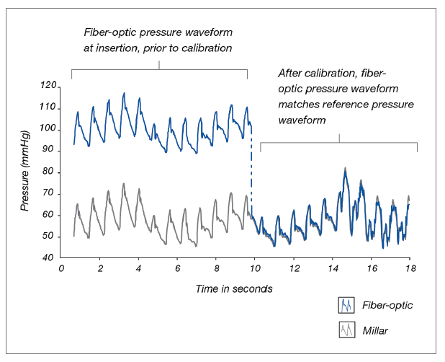
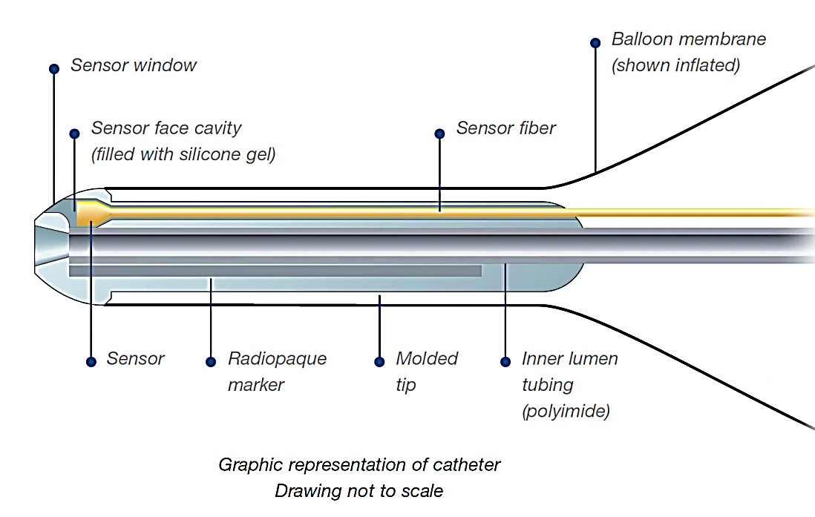
Getinge Fiber-optic Technology
A miniature pressure sensor is mounted inside the tip of the IAB
Light travels from the pump through the fiber-optic cable to the pressure sensor
The sensor responds to the arterial pressure and creates a light pattern that is sent back to the CS300® and Cardiosave® IABPs
The pump translates the light pattern into pressure readings for accuracy in measuring pressure
Yarhman G et al. Perfusion 18(2) 97-102 September 2012
Notes:
Fiber-optic technology is a way to minimize the inaccuracies of a fluid-filled system. It uses a miniature pressure sensor at the end of the IAB catheter. Light then travels from the pump through the fiber-optic cable to the pressure sensor. The sensor responds to the arterial pressure and creates a light pattern that is sent back to the Cardiosave IABP. Once there it is translated into the pressure waveform seen on the pump.
The accuracy has been verified by utilizing a comparison to the Millar catheter which is considered the gold standard of pressure measuring devices. As you can see in the picture the pressures were nearly identical.

Slide 15
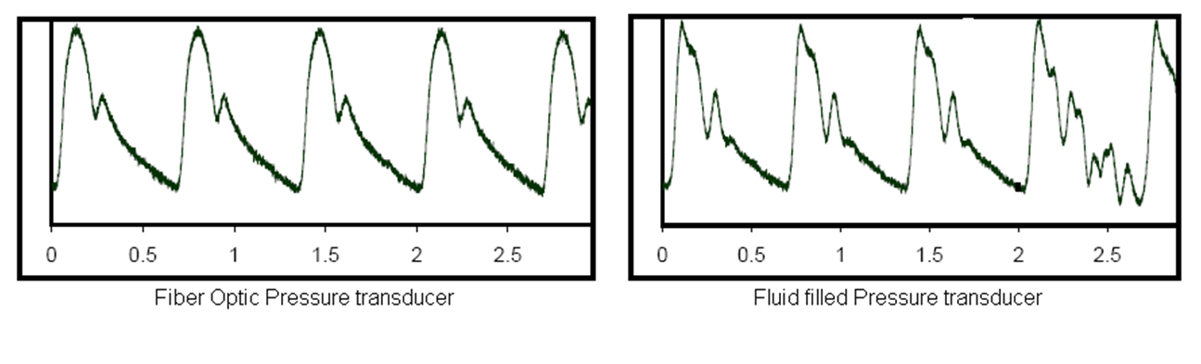
IABP Fiber-optic Pressure Technology
Hamel C et al. Progress in Biomedical Optics and Imaging 2006;7(6):608306.1-608306.10
Notes:
The fiber-optic signal does not have all of the potential challenges that can cause the waveform to be damped. This allows for a crisp, clean pressure fiber-optic waveform.

Slide 16
Benefits of Fiber-optic Technology
Fiber optics deliver the signal 50msec faster than fluid filled transducers
Utilizing this signal, the improved timing can more accurately adjust timing on a beat to beat basis
The option to automatically calibrate and recalibrate in vivo further improves the accuracy and monitoring of the fiber-optic technology
Yarhman G, Perfusion 18(2) 97-102 September 2012
Notes:
Light is faster than a signal through water making the fiber-optic signal up to 50msec faster than a fluid-filled transducer. Utilizing this signal can help to improve the accuracy of the timing of the IABP. The Cardiosave and CS300 Getinge IABPs have the ability to automatically calibrate and recalibrate the fiber-optic catheters. This removes the need for the clinician to level and zero the catheter minimizing the impact of user error.

Slide 17
Summary of Clinical Advantages of Fiber-optic Technology
Features | Patient/Clinician Benefits
Reliable arterial pressure waveform | Immune to artifact More accurate timing for optimized therapy Less troubleshooting required
Instantaneous signal transmission | Signal received 50 msecs faster than fluid-filled transducers Faster response to rate and rhythm changes
Faster time to therapy | One touch start-up ensures a faster and easier process to initiate therapy, which is critical with acute patients
AP waveform immune to ESI | Pump maintains therapy during electro-surgical interference
Notes:
To summarize, the advantages of fiber-optic technology are:
A more reliable signal which allows for more accurate timing to optimize therapy and less troubleshooting.
Instantaneous signal transmission up to 50msecs faster that will allow for a faster response to rate and rhythm changes.
Faster time to therapy for the Getinge IABP with one button start and automatic in the body (in vivo) calibration.
Clean crisp signal immune to electro-surgical interference.
With Cardiosave and Sensation Plus, there is no need to miss a beat.

Slide 18
Higher efficacy intra-aortic balloons

Slide 19
Factors Affecting Hemodynamic Effect of IAB Therapy
Factors affecting optimal hemodynamic effect
Balloon’s position in the aorta
Timing of balloon in diastole and deflation in systole
Patient’s heart rate, blood pressure and vascular resistance
Blood displacement volume
Balloon diameter in relation to aortic diameter
Rihal, C et al. J Am Coll Cardiol. 2015 May 19;65(19):e7-e26
Notes:
Obtaining optimal augmentation is dependent on the position of the balloon in the aorta, appropriate timing, the patients heart rate, blood pressure and vascular resistance, the amount of blood displaced and whether the diameter of the balloon is proper for the size of the aorta. Typically the aorta is 22-25mm. A smaller diameter balloon will not fill as much of the aorta causing a sub-optimal augmentation.

Slide 20
High Efficacy IAB Catheters
Larger volume balloons like Mega® and Sensation Plus® provide greater hemodynamic support
Larger volume balloons displace more blood volume in aorta during diastole
The 50cc IAB can displace up to 25% more volume*
This results in improved augmentation and unloading
IAB therapy using a larger volume 50cc balloon appears effective as a first line percutaneous MCS strategy in a large fraction of critically ill cardiac patients with few adverse events¹
* Bench testing completed by Getinge. Data on file. Bench test results are not
necessarily predictive of clinical results.
Visveswaran,G et al. Cath Cardiovasc Intervent 2017; 90: e63-72
Notes:
Getinge has created two lines of larger volume balloons, Mega and Sensation Plus. The larger diameter provides greater support and a higher efficacy. The 50cc IAB can displace up to 25% more volume resulting in a improved augmentation and greater systolic unloading. Using the larger diameter 50cc IAB appears to be an effective first line mechanical circulatory support strategy for many critically ill cardiac patients with few adverse events.

Slide 21
Getinge IAB Catheters
Notes:
Getinge has two lines of high efficacy IAB catheters, the conventional fluid-filled Mega and the fiber-optic Sensation Plus.

Slide 22
IAB Catheter Sizing
5.0%
5.5%
4.8%
3.7%
Notes:
The new high efficacy balloons come with a new sizing guide. The balloons are larger in diameter but similar in length to the older Linear IAB. The 50cc Mega and Sensation Plus is 17.4mm in diameter, an extra 2.4mm, which allows for additional filling of the aorta. This catheter is on an 8Fr. catheter and is for patients that are 5’4” or taller. The Mega and Sensation Plus 40cc IAB is 16mm, 1mm larger than the old 34cc Linear. It is on a 7.5Fr. catheter and is for patients 5’0” – 5’4”. The Mega also comes in a 30cc IAB which is 16mm in diameter, 1mm larger in diameter than the old 25cc Linear. It is for patients less than 5’ tall.

Slide 23
Clinical evidence for 50cc IAB

Slide 24
Hemodynamic Effects of Standard vs. Larger-Capacity Intra-Aortic Balloon Counterpulsation Pumps
Kapur, et al. Journal of Invasive Cardiology Vol. 27, No. 4, April 2015
Objective
Methods
Data obtained
Explore the hemodynamic effects of the 50 cc IABP in real-world clinical practice
Retrospective review of 52 patients
n=26 40cc IAB
n=26 50cc IAB.
Demographics
Indication for use: acute decompensated heart failure (ADHF); cardiogenic shock (CGS); acute coronary syndrome (ACS); high-risk coronary intervention (HR-PCI)
Hemodynamic data
Clinical outcomes: In-hospital mortality and device associated complications
Notes:
There have been three studies looking at the improved hemodynamics of the 50cc IAB. The first one is from Tufts Medical Center. The primary investigator was Dr. Navin Kapur.

Slide 25
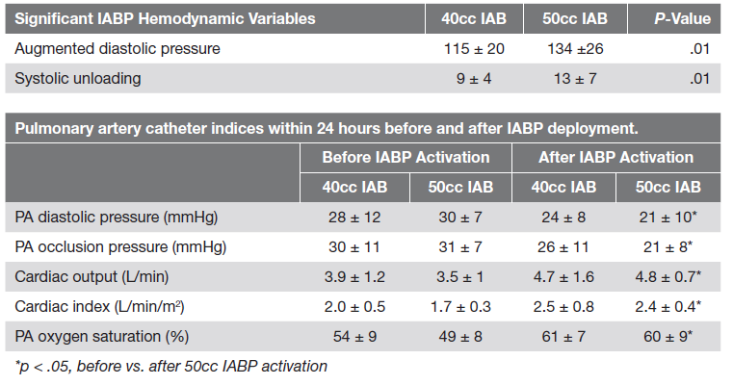
Hemodynamic Effects of 40cc vs. 50cc IAB
Results: Hemodynamic variables
Note: PA catheter data available before and after IAB implantation in 20 patients
Kapur et al. J Invasive Cardiol 2015;27(4):182-188
Notes:
The study looked at the hemodynamic parameters before and after activation of a 40cc and 50cc IAB. Each arm had 26 patients. All of the parameters were better with the 50cc IAB catheter. A parameter of particular interest is the change in the pulmonary artery saturation. This indicates general oxygenation. There was an 11% improvement with the 50cc catheter vs 7% with the 40cc catheter. There was also significant change in the pa pressures and both the cardiac output and index.

Slide 26
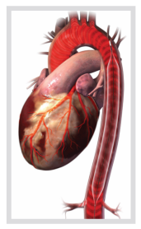
Hemodynamic Effects of 40cc vs. 50cc IAB
Results: Hemodynamic variables
Within 24 hours of 50cc IAB activation:
PA diastolic and occlusion pressures were reduced
Hemodynamics change
CO
CI
PA oxygen saturation pressures increased
Absolute change in CO
0.7 L/min (18%) in the 40cc group
1.4 L/min (40%) in the 50cc group (p=.08)
Kapur et al. J Invasive Cardiol 2015;27(4):182-188
Notes:
Within 24 hours the hemodynamic effects all showed a greater improvement with the 50cc vs 40cc IAB with a 1.4L/min or 40% absolute difference in the cardiac output vs only a 18% or 0.7 L/min for the 40cc catheter.

Slide 27
A Single Center Tertiary Care Experience Utilizing the Large Volume Mega® 50cc Intra-Aortic Balloon Counterpulsation in Contemporary Clinical Practice
Visveswaran et al. Catherization and Cardiovasc Interv 2017 Oct 1;90(4):E63-E72
Objective
Methods
Primary Outcome
Evaluate clinical outcomes and adverse events utilizing the large volume 50cc intra-aortic balloon (IAB) in contemporary clinical practice
Retrospective, single center review of all patients who received a 50cc IAB from 2011 through 2015
Total cohort n=150; CS sub-group n=100; Non-CS n=50 patients
Clinical outcomes: serial renal function and survival to hospital discharge

Slide 28
Hemodynamics with the 50cc IAB Catheter
Positive hemodynamic data exceeded some of the data reported in Kapur et al 40cc vs. 50cc comparison
+ 42 mmHg diastolic augmentation
- 15 mmHg systolic unloading
- 7 mmHg diastolic unloading
+ 1.06 L/min cardiac output
+ 0.56 L/min/m² cardiac index
 | N= | Pre-IAB | Post IAB | P value
Diast Aug (mm Hg) | 115 | - | 42
PASP (mm Hg) | 87 | 55 | 45 | < 0.01
PADP (mm Hg) | 87 | 28 | 22 | < 0.01
mPAP (mm Hg) | 87 | 38 | 29 | < 0.01
C.O. (l/min) | 79 | 3.56 | 4.50 | < 0.01
C.I. (l/min/m²) | 79 | 1.76 | 2.32 | < 0.01
Visveswaran,G et al. Cath Cardiovasc Intervent 2017; 90: e63-72
Notes:
The results showed an even greater response in some of the parameters than reported in Dr. Kapur’s. In the patients with CS, the authors observed a 66%
rate of survival to hospital discharge after 50cc IABC, as the first MCS strategy, with escalation as needed.

Slide 29
Differential Responses to Larger Volume Intra-Aortic Balloon Counterpulsation: Hemodynamic and Clinical Outcomes
Baran, D et al, Cath Cardiovasc Intervent 2018 Oct 1;92(4):703-710
Objectives
Methods
Examine hemodynamic and clinical correlates of use of an intra-aortic balloon pump catheter in a single center
Seventy-six patients had paired measurements of cardiac output
All patients who received IABC with a 50cc balloon for at least 1 hour were included in this retrospective chart review study.
Demographics, comorbidities, lab values, and hemodynamic parameters were recorded at baseline and 15 hours post insertion
Notes:
In the third study, Dr. Baran et al looked at the previous study to determine if there were differences in how patients responded to IAB therapy. The study looked at a total of 76 patients that had right heart caths. 60 or 79% were responders to IAB therapy were 16 or 21% were non-responders. This study demonstrated that the majority of patients improve their cardiac output with a 50cc IABC but survival was unchanged.

Slide 30
Improvement in Cardiac Output With 50cc IAB
This study along with the prior work on the 50 cc IAB¹ catheter provide an evidence base for rational use of the IABC when managing cardiogenic shock
Not all patients respond the same to IAB therapy
79% of patients were responders with significant increases from baseline in cardiac output and index following IAB placement (p <0.0001 for both comparisons)²
CO - 1.6 L/min (3.661.3 L/min to 5.261.8 L/min)
CI - 0.8 L/min (1.860.5 L/min/m² to 2.660.8 L/min/m²)
1. Visveswaran G. et al. Cath Cardiovasc Intervent 2017; 90: e63-72
2. Baran, D et al, Cath Cardiovasc Intervent 2018 Oct 1;92(4):703-710
Notes:
How a patient responds to any given treatment can vary. This study demonstrates that most patients did respond positively to IABP therapy. The average improvement in the cardiac output was 1.6 L/min and cardiac index 0.8 L/min/m². In particular, the patients who have the most significant response to IABC are those with the lowest cardiac output, and cardiac power index along with elevated right atrial and pulmonary artery diastolic pressures. In addition, the magnitude of the response is higher than that previously reported with smaller size IABC catheters but it did not lead to a difference in mortality a survival to discharge of 72%. The other major finding of this study is that simply improving the cardiac output does not correlate with ultimate outcome. Devices such as the Tandem Heart and the Impella (2.5 or CP) have not convincingly improved clinical outcomes in cardiogenic shock either above and beyond IABC. There is still more to learn about cardiogenic shock.

Slide 31
Improvement in Cardiac Output With High Efficacy Balloon
 | Kapur n=26 | Visveswaran n=150 | Baran n=60
CO* | + 1.4 L/min | + 1.03 L/min | + 1.6 L/min
CI* | + 0.7 L/min/m² | + 0.46 L/min/m² | + 0.8 L/min/m²
n | 26 | 150 | 60
The net result of the larger-capacity IABPs is a significant reduction in cardiac filling pressures and augmentation in cardiac output.
1. Kapur et al. J Invasive Cardiol 2015;27(4):182-188
2. Visveswaran, G. Cath Cardiovasc Intervent 2017; 90: e63-72
3. Baran, D et al, Cath Cardiovasc Intervent 2018 Oct 1;92(4):703-710
Notes:
There are now three studies showing the increase in cardiac output from the 50cc IAB is greater than the 0.5 L/min reported in the past. Given that all past IAB trials were done with 40cc IAB, it raises the question if the outcomes might have been different with the greater support of the 50cc Mega or Sensation Plus.

Slide 32
Safety of the 50 cc IAB catheter
IAB therapy with a high efficacy balloon has a low incidence of complications
Bleeding requiring transfusion 3.3%
Major vascular complications 0.7%
Minor complications 2%
Visveswaran, G et al. Cath Cardiovasc Intervent 2017; 90: e63-72
Notes:
Safety is a key concern and bleeding can significantly impact outcomes. Although the 50cc IAB catheter is an 8Fr. catheter, the risk of complications remains low.

Slide 33
Sensation Plus® Fiber-optic IAB Catheter
Fiber-optic Technology
Faster time to therapy
In vivo calibration
Greater Hemodynamic Support
50cc vs. 40cc for patients 5’4” (162cm) and taller
25% more blood volume displacement 40cc vs. 50cc*
18% more blood volume displacement 34cc vs. 40cc*
Improved unloading and augmentation
Statlock® IAB Stabilization Devices
2 Statlock® IABs inside the box
* Bench testing completed by Getinge. Data on file. Bench test results are not ecessarily predictive of clinical results.
Notes:
To summarize, the fiber-optic benefit of the Sensation Plus, a one button start up, automatic calibration in the body and recalibration every two hours provides a faster time to therapy with a cleaner more accurate waveform. Combined with the high efficacy larger volume balloon, your patients will receive greater systolic unloading, higher augmentation with the potential of a greater increase in cardiac output than the older 40cc balloons.
Sensation Plus Brochure 0002-08-1061
Sensation Plus Launch Presentation ML-0327

Slide 34
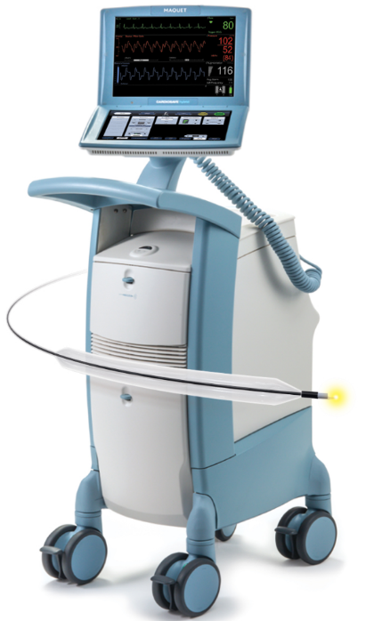
Cardiosave® Platform
With Cardiosave® and a Sensation Plus® Catheter
One button to initiate therapy
Instant signal transmission
Crisp, clean arterial pressure waveform
Automatic in-vivo calibration
Up to cardiac 1.6 L/min of cardiac output
When your patient need supports, count on Cardiosave® with a high-efficacy balloon as your first line of mechanical circulatory support
Baran, D et al, Cath Cardiovasc Intervent 2018 Oct 1;92(4):703-710

