Slide 1
Patient Blood Management
In-service Guide
Using Blood Recovery Unit (BRU) drains for continuous ATS
MCV00095110 REVA

Slide 2
Advantages of Continuous ATS
Closed system
Minimizes risk of nurse exposure to blood
Minimizes patient touchpoints and need for multiple blood bag exchanges for the same blood volume
Reduces potential for contamination with disconnection of ATS bags and replacements
No need to clamp off the patient tube
No interruption in patient drainage

Slide 3
What is needed for Continuous ATS?

Slide 4
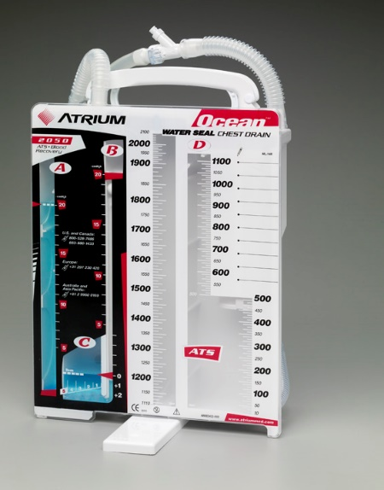
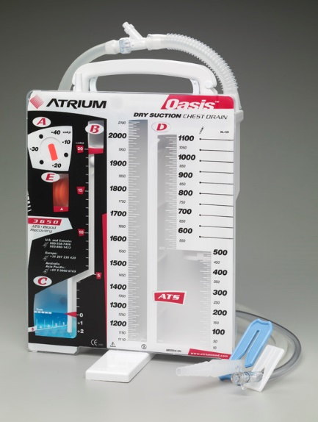
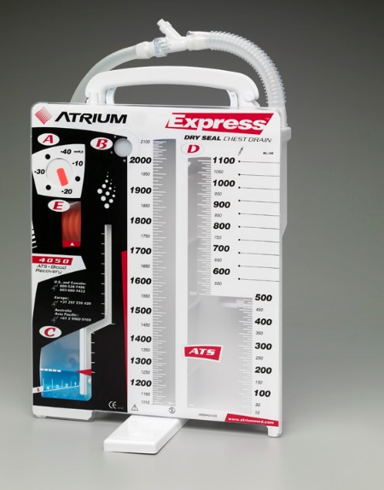
Remember: Continuous ATS can be done with any Blood Recovery Unit (BRU) drain (Ocean 2050, Oasis 3650, Express 4050)
Ocean 2050 Oasis 3650 Express 4050

Slide 5
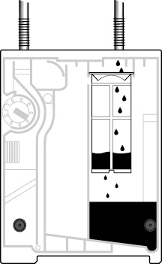
Closer look at blood filter chamber design
300ml capacity stented design filter of 200 microns, not in-line with patient tube to avoid fluid back-up
Sump port located at the bottom of the collection chamber to allow total reinfusion of drainage

Slide 6
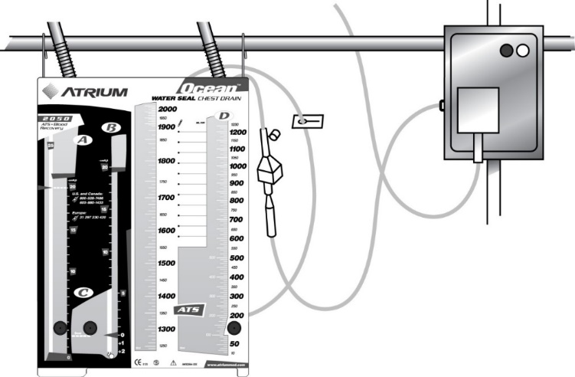

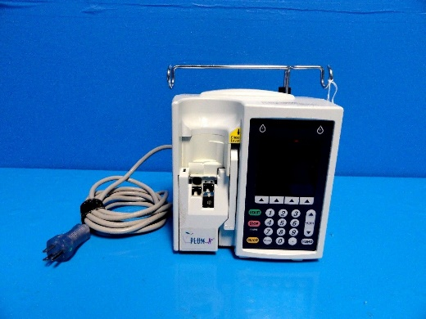
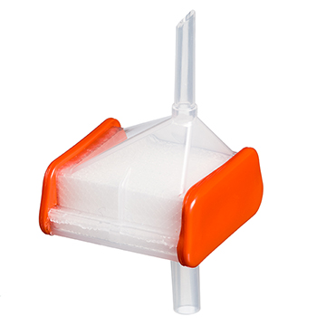
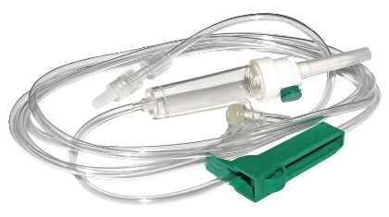
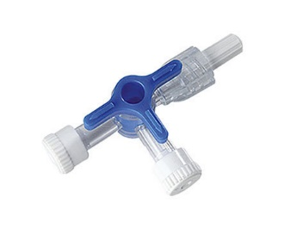
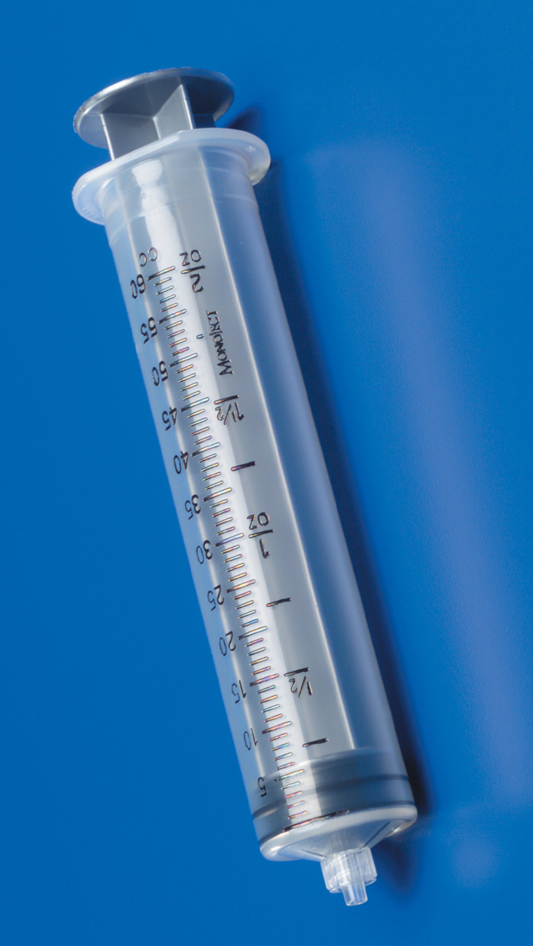
Continuous ATS requires the following:
1) BRU drain (Ocean 2050, Oasis 3650, Express 4050)
2) 40micron micro-emboli filter
3) Blood-compatible, non-vented IV tubing
4) Blood-compatible, infusion pump
5) 3-way stopcock
6) 60cc syringe

Slide 7
Continuous ATS Set-up with non-self priming pumps

Slide 8
Continuous ATS Set-up: Using non-self priming pump
Can be primed by aspirating air out of the IV circuit with a 3-way stopcock & syringe; or pre-primed with saline prior to attachment to the blood filter*
Clamp off drain’s blood access line
Drape access line up around the patient tube or hanger prior to filter spiking (keeps drip chamber in an upright position)
Remove the spike port cap and insert the micro emboli filter using a firm twisting motion
*Most pumps do not require saline. Refer to pump manufacturer’s IFU

Slide 9
Continuous ATS Set-up: Using non-self priming pump
Spike the non-vented blood IV set directly into the filter
Attach 3-way stopcock to the distal (patient) end of the IV set
Connect a 60cc Luer lock syringe to side port of the 3-way stopcock & open the free flow setting on the pump cassette, if provided
Turn filter in “spike down” position so blood will flow up through the filter & drip chamber

Slide 10
Pump Set-up: Non-self priming
Unclamp access line and IV tubing
With 60cc syringe, slowly aspirate from the drain, making sure the filter and drip chamber remain upside down
When drip chamber is ~1/4 full with blood, turn filter & drip chamber right side up (spike up) and continue purging air from line & connect to pump when complete
Final priming with pump by purging all air prior to patient connection (or alarm will go off)
Set pump to desired volume & ml/hour rate

Slide 11
Continuous ATS Set-up with self priming pumps

Slide 12
Pump Set-up: Self priming infusion pump
Most self-priming pumps do not require IV set priming with saline
Insert micro-emboli blood filter into ATS access line and attach a non-vented IV set to the filter. Insert IV set into pump – Set pump to priming mode
Open ATS access line clamp & start priming until all air from ATS line
When drip chamber is ~1/4 full with blood, turn filter & drip chamber right side up (spike up)
Complete purging of air from the IV set
Set pump to desired volume & rate

Slide 13
Recording Patient Drainage
Refer to hospital protocol for specific ATS time intervals & volume
Common method = hourly basis
  set the pump to infuse total available blood volume in drain during next hour
  Then, total volume remaining in drain = amount patient has drained in last hour

Slide 14
Recording Patient Drainage
Recording drainage is facilitated by sump port located at bottom of drain…. simple & easy…all blood is reinfused
To determine partial hour or incremental chest tube drainage during continuous ATS, the following formula is suggested:

Slide 15
Recording Patient Drainage
Total Volume Autotransfused (from pump reading or last recorded ATS total from flow sheet column total infused during current infusion setting)
        (+)
Priming Volume at Initial Setup
        (+)
Total Blood Currently in Drain (read directly from drain)
        (-)
Last Recorded Total Chest Tube Output (from chest tube or flow sheet column)
        (=)
Blood Loss Since Last Recording

Slide 16

AABB Guidelines
Standards for Perioperative Autologous Blood Collection and Administration
(7th edition, effective 01 Jan 2017)
Handling, Storage, and Expiration of Perioperative Autologous Red Cell Blood Components
(Reference Standard 5.1.8A; page 24-25)
Time from the Start of Collection to Expiration: 8 hours
Storage temperature: Room temperature
These conditions apply to the following types of blood:
    Intraoperative blood recovery without processing
    Shed blood under postoperative or posttraumatic conditions with or without processing
    Acute normovolemic hemodilution (whole blood)

Slide 17

Thank you!!
Atrium chest drains are manufactured by Getinge, 40 Continental Blvd, Merrimack, NH 03054 USA. CAUTION: Federal Law (U.S.A.) restricts this device to sale by or on the order of a physician.• Protected by the following international and U.S. patent(s): http://patents.maquet.com. • Getinge and Atrium are trademarks or registered trademarks of Getinge AB, its subsidiaries or affiliates in the United States or other countries • Getinge and Atrium are registered with the U.S. Patent and Trademark Office. • Copyright 2019 Atrium Medical Corp. • All rights not expressly granted are reserved. • Refer to Instructions for Use for current indications, warnings, contraindications, and precautions. • Printed in U.S.A. • 08/2019 • PN 011405 Rev AA
Getinge • 40 Continental Blvd • Merrimack, NH 03054 • USA • Tel. (603) 880-1433
www.getinge.com

